Slide 1
Agile Development

Slide 2
What is “Agility”?
Effective (rapid and adaptive) response to change (team members, new technology, requirements)
Effective communication in structure and attitudes among all team members, technological and business people, software engineers and managers。
Drawing the customer into the team. Eliminate “us and them” attitude. Planning in an uncertain world has its limits and plan must be flexible.
Organizing a team so that it is in control of the work performed
Eliminate all but the most essential work products and keep them lean.
Emphasize an incremental delivery strategy as opposed to intermediate products that gets working software to the customer as rapidly as feasible.

Slide 3
What is “Agility”?
Rapid, incremental delivery of software
The development guidelines stress delivery over analysis and design although these activates are not discouraged, and active and continuous communication between developers and customers.

Slide 4
Agility Principles
Our highest priority is to satisfy the customer through early and continuous delivery of valuable software.
Welcome changing requirements, even late in development.
Deliver working software frequently, from a couple of weeks to a couple of months, with a preference to the shorter timescale.

Slide 5
Agility Principles
Business people and developers must work together daily throughout the project.
Build projects around motivated individuals. Give them the environment and support they need, and trust them to get the job done.
6. The most efficient and effective method of conveying information to and within a development team is face–to–face conversation

Slide 6
Agility Principles
Working software is the primary measure of progress.
Agile processes promote sustainable development. The sponsors, developers, and users should be able to maintain a constant pace indefinitely.
Continuous attention to technical excellence and good design enhances agility.

Slide 7
Agility Principles
10. Simplicity – the art of maximizing the amount of work not done – is essential.
11. The best architectures, requirements, and designs emerge from self–organizing teams.
12. At regular intervals, the team reflects on how to become more effective, then tunes and adjusts its behavior accordingly.

Slide 8
An Agile Process
Mainly 3 key assumptions:
  It is difficult to predict in advance which software requirements will persist and which will change…as well as how customer priorities will change as project proceeds.
  Design and construction are interleaved for many software. So both the activities should be performed in tandem so that design models are proven as they created.
  Analysis, design, construction and testing are not as predictable .
  So the Question is..
  How we create a process that can manage unpredictability?
  Answer is:
  Process Adaptability.

Slide 9
Human Factors
Agile Development focuses on talent and skills of individuals, molding the process to specific people and team, not the other way around
key traits must exist among the people on an agile team and the team itself:
  Competence. talent, specific software related skills, overall knowledge of process that the team has chosen to apply.
  Skill and knowledge of process can and should be taught to all people who serve as agile team members.

Slide 10
Common focus. All team members should be focused on one goal—to deliver a working software increment to the customer within the time promised though they work on different phases.
Collaboration. Software engineering is about assessing, analyzing, and using information that is communicated to the software team;
  To accomplish these tasks, team members must collaborate with one another and all other stakeholders.

Slide 11
Human Factors
  Decision-making ability. freedom to control its own destiny
  Fuzzy problem-solving ability. ambiguity and constant changes, today problem may not be tomorrow’s problem
  Mutual trust and respect.
  Self-organization.
  Organize itself for the work to be done,
  Organize the process to best accommodate its local environment,
  Organize the work schedule to best achieve delivery of s/w increment.

Slide 12
Agile Process Models

Slide 13
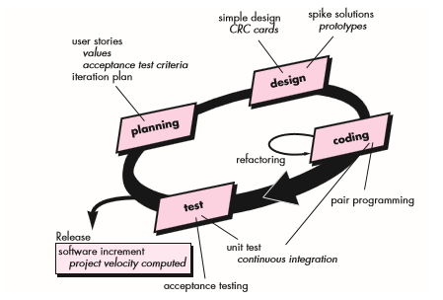
Extreme Programming (XP)

Slide 14
Extreme Programming (XP)
The most widely used agile process, originally proposed by Kent Beck in 2004. It uses an object-oriented approach.
XP Planning
  Begins with the listening, leads to creation of “user stories” that describes required output, features, and functionality. Customer assigns a value(i.e., a priority) to each story.
  Agile team assesses each story and assigns a cost (development weeks. If more than 3 weeks, customer asked to split into smaller stories)
  Working together, stories are grouped for a deliverable increment next release.

Slide 15
  A commitment (stories to be included, delivery date and other project matters) is made. Three ways: 1. Either all stories will be implemented in a few weeks,
  2. high priority stories first, or
  3. the riskiest stories will be implemented first.
  After the first increment “project velocity”, namely number of stories implemented during the first release is used to help define subsequent delivery dates for other increments. Customers can add stories, delete existing stories, change values of an existing story, split stories as development work proceeds.

Slide 16
Extreme Programming (XP)
XP Design ( occurs both before and after coding as refactoring is encouraged)
  Follows the principle (keep it simple) Nothing more nothing less than the story.
  Encourage the use of CRC (class-responsibility-collaborator) cards in an object-oriented context. The only design work product of XP. They identify and organize the classes that are relevant to the current software increment.

Slide 17
  For difficult design problems, suggests the creation of “spike solutions”—a design prototype for that portion is implemented and evaluated.
  Encourages “refactoring”—an iterative refinement of the internal program design. Does not alter the external behavior yet improve the internal structure. Minimize chances of bugs. More efficient, easy to read.

Slide 18
Extreme Programming (XP)
XP Coding
  Recommends the construction of a unit test for a story before coding commences. So implementer can focus on what must be implemented to pass the test.
  Encourages “pair programming”. Two people work together at one workstation. Real time problem solving, real time review for quality assurance. Take slightly different roles.

Slide 19
XP Testing
  All unit tests are executed daily and ideally should be automated. Regression tests are conducted to test current and previous components.
  “Acceptance tests” are defined by the customer and executed to assess customer visible functionality

Slide 20
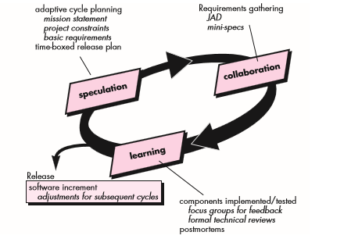
Adaptive Software Development

Slide 21
Adaptive Software Development (ASD)
Originally proposed by Jim High smith (2000)focusing on human collaboration and team self-organization as a technique to build complex software and system.
ASD — distinguishing features
  Mission-driven planning
  Uses “time-boxing”
  Explicit consideration of risks
  Emphasizes collaboration for requirements gathering
  Emphasizes “learning” throughout the process

Slide 22
Three Phases of ASD
1. Speculation: project is initiated and adaptive cycle planning is conducted. Adaptive cycle planning uses project initiation information- the customer’s mission statement, project constraints (e.g. delivery date), and basic requirements to define the set of release cycles (increments) that will be required for the project. Based on the information obtained at the completion of the first cycle, the plan is reviewed and adjusted so that planned work better fits the reality.

Slide 23
Three Phases of ASD
2. Collaborations: People worked together to multiply their talent and creative output beyond absolute number (1+1>2). It encompasses communication and teamwork, but it also emphasizes individualism, because individual creativity plays an important role in collaborative thinking.
It is a matter of trust. 1) criticize without animosity, 2) assist without resentments, 3) work as hard as or harder than they do. 4) have the skill set to contribute to the work at hand, 5) communicate problems or concerns in a way that leas to effective action.

Slide 24
Three Phases of ASD
3. Learning: As members of ASD team begin to develop the components, the emphasis is on “learning”.
High smith argues that software developers often overestimate their own understanding of the technology, the process, and the project and that learning will help them to improve their level of real understanding.
ASD team learns in 3 ways
focus groups: Feed back from customers and/or end users
technical reviews : Team members review s/w components
project postmortems: ASD team becomes introspective, addressing its own performance and process.

Slide 25
Dynamic Systems Development Method
It is an agile software development approach that provides a framework for building and maintaining systems which meet tight time constraints through the use of incremental prototyping in a controlled project environment.
Promoted by the DSDM Consortium
DSDM—distinguishing features
  Similar in most respects to XP and/or ASD
  Also suggest an iterative software process.

Slide 26
DSDM Life Cycle
  Feasibility study: establishes the basic business requirements and constraints associated with the application to be built and then assesses whether the application is a viable candidate for the DSDM process.
  Business study: Establishes the functional and information requirements that will allow the application to provide business value; also, defines the basic application architecture and identifies the maintainability requirements for the application.
  Functional model iteration: Produces a set of incremental prototypes that demonstrate functionality for the customer.
  gather additional requirements by eliciting feedback from users as they exercise the prototype.

Slide 27
  Design and build iteration: Revisits prototypes built during functional model iteration to ensure that each has been engineered in a manner that will enable it to provide operational business value for end users.
  Implementation: Places the latest software increment into the operational environment.
    It should be noted that (1) the increment may not be 100 percent complete or (2) changes may be requested as the increment is put into place.

Slide 28
Scrum
A software development method Originally proposed by Schwaber and Beedle (an activity occurs during a rugby match) in early 1990.
Scrum—distinguishing features
  Development work is partitioned into “packets”
  Testing and documentation are on-going as the product is constructed
  Work units occurs in “sprints” and is derived from a “backlog” of existing changing prioritized requirements
  Changes are not introduced in sprints (short term but stable) but in backlog.
  Meetings are very short (15 minutes daily) and sometimes conducted without chairs ( what did you do since last meeting? What obstacles are you encountering? What do you plan to accomplish by next meeting?)
  “demos” are delivered to the customer with the time-box allocated. May not contain all functionalities. So customers can evaluate and give feedbacks.

Slide 29
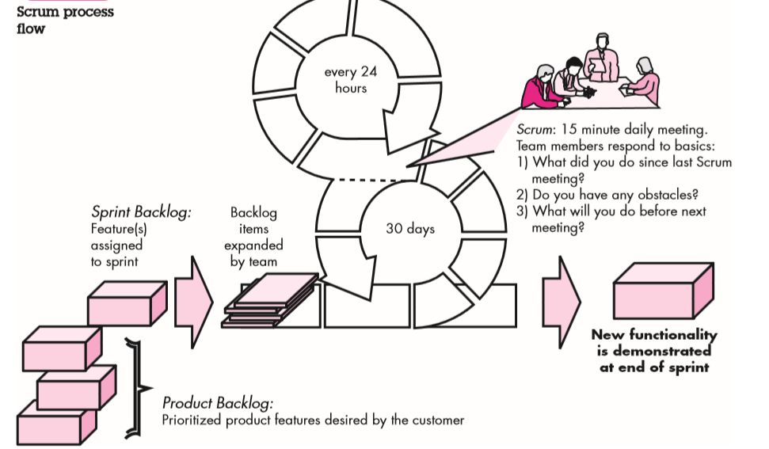
Scrum

Slide 30
Crystal
Proposed by Cockburn and Highsmith
Crystal—distinguishing features
  Actually a family of process models that allow “maneuverability” based on problem characteristics
  Defined a set of methodologies, each with core elements that are common to all, and roles, process patterns, work products, and practice that are unique to each.
  Face-to-face communication is emphasized
  Suggests the use of “reflection workshops” to review the work habits of the team

Slide 31
Feature Driven Development
Originally proposed by Peter Coad et al as a object-oriented software engineering process model.
FDD—distinguishing features
  Emphasis is on defining “features” which can be organized hierarchically.
    a feature “is a client-valued function that can be implemented in two weeks or less.”
  Uses a feature template
    <action> the <result> <by | for | of | to> a(n) <object>
    E.g. Add the product to shopping cart.
    Display the technical-specifications of the product.
    Store the shipping-information for the customer.
  A features list is created and “plan by feature” is conducted
  Design and construction merge in FDD

Slide 32
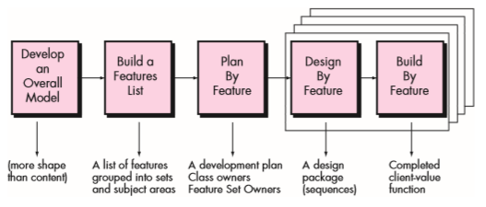
Feature Driven Development

Slide 33
Agile Modeling
Originally proposed by Scott Ambler
Suggests a set of agile modeling principles
  Model with a purpose: A developer who uses AM should have a specific goal (e.g., to communicate information to the customer or to help better understand some aspect of the software) in mind before creating the model.
  Use multiple models: There are many different models and notations that can be used to describe software.
  Travel light: As software engineering work proceeds, keep only those models that will provide long-term value and jettison the rest.

Slide 34
  Content is more important than representation: Modeling should impart information to its intended audience.
  Know the models and the tools you use to create them: Understand the strengths and weaknesses of each model and the tools that are used to create it.
  Adapt locally: The modeling approach should be adapted to the needs of the agile team.

